Slide 1
Q-Learning in Reinforcement Learning

Slide 2
What is Reinforcement Learning?
Learning by interaction with environment
Agent takes actions → receives rewards
Goal: Maximize cumulative reward
Key Elements: Agent, Environment, State, Action, Reward

Slide 3
What is Q-Learning?
Model-free reinforcement learning algorithm
Learns optimal policy(Bellman Optimality Principle) without knowing environment
Uses Q-values

Slide 4
Q-Value Concept
Q(s, a): Expected reward of action a in state s
Stored in Q-table

Slide 5
Q-Learning Equation
Q(s,a) = Q(s,a) + α [R + γ max Q(s',a') - Q(s,a)]
α: learning rate, γ: discount factor

Slide 6
Algorithm Steps
1. Initialize Q-table
2. Choose action
3. Take action → reward
4. Update Q-value
5. Repeat

Slide 7
Learning Parameters
Learning rate (α)
Discount factor (γ)
Exploration rate (ε)

Slide 8
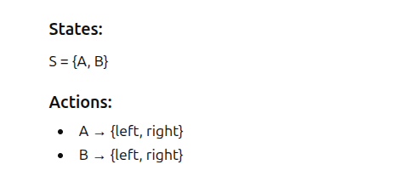
Example
Action Sequence: A to B, B to A, A to A.

Slide 9
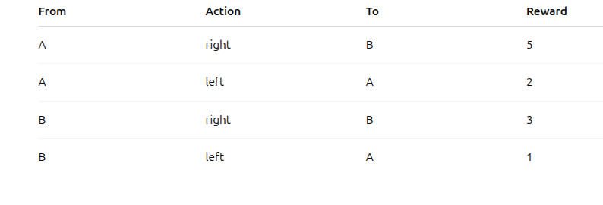
Rewards

Slide 10
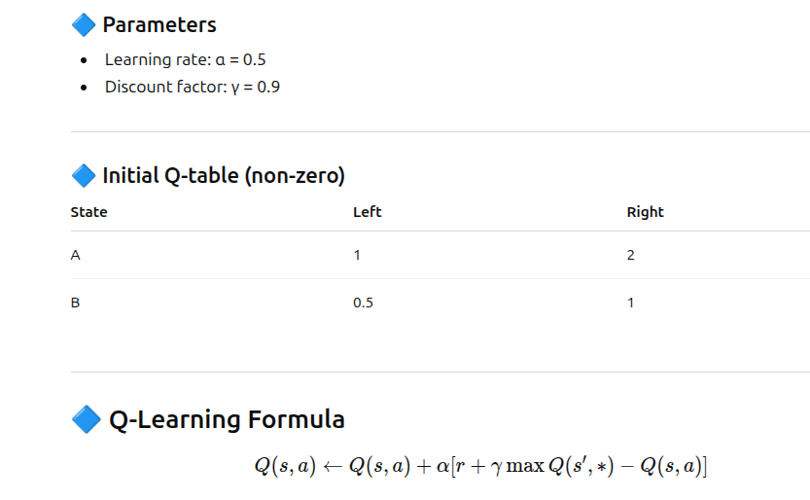

Slide 11
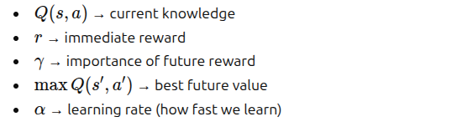

Slide 12
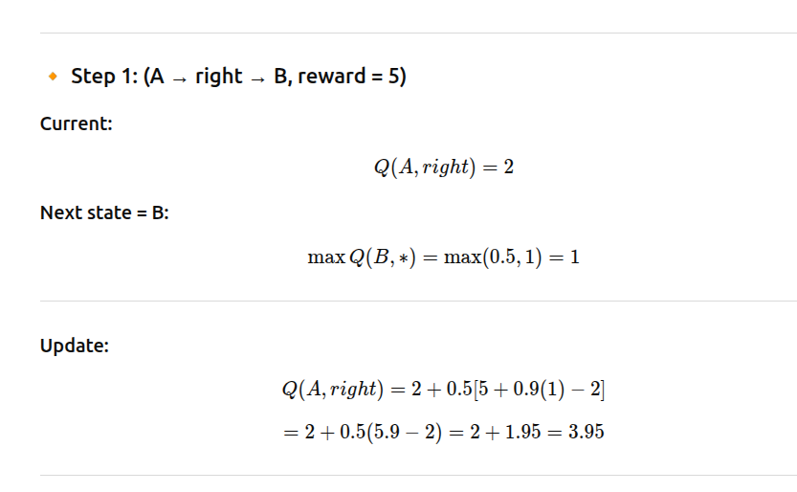

Slide 13
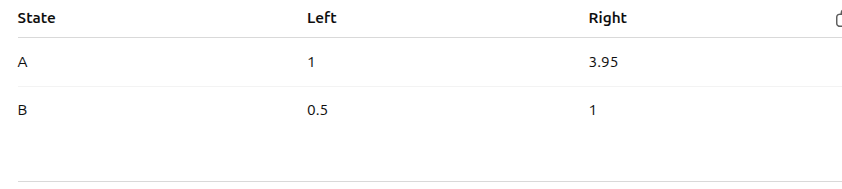
Updated Q Table

Slide 14
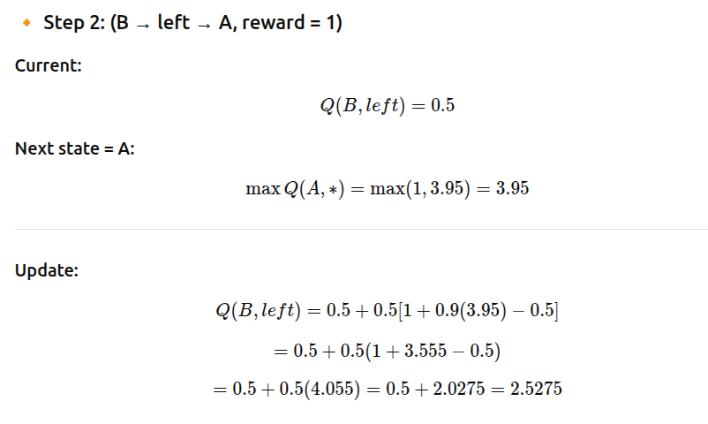

Slide 15
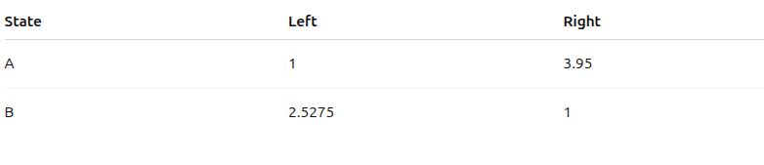
Updated Q table

Slide 16
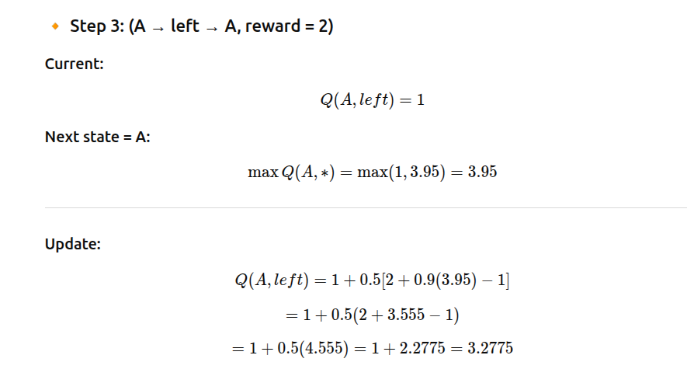

Slide 17
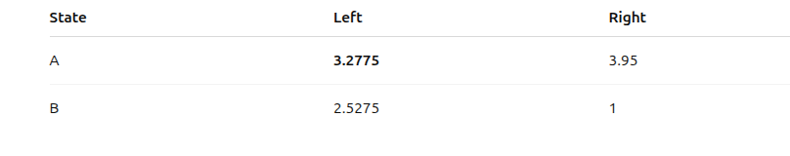
Updated Q table

Slide 18
Final Policy
At A → right (3.95 > 3.2775)
At B → left ( 2.5275 > 1)

Slide 19
Policy
Policy = Best action in each state
Derived from Q-table

Slide 20
Advantages
No model required
Simple implementation
Works for small problems

Slide 21
Limitations
Large state space → huge Q-table
Slow convergence
Not for continuous spaces

Slide 22
Applications
Robotics
Game playing
Path optimization
Recommendation systems

